Slide 1
Disorders of CHO metabolim
By
Dr.Qutaiba A. Qasim
Ph.D Clinical Biochemistry
2020

Slide 2
Functions of extracellular glucose
-The main function of glucose is a major tissue energy source (glycolysis and the Krebs cycle).
-The brain is highly dependent upon the extracellular glucose concentration for its energy supply ( about 60% of whole body utilization) ; therefore; hypoglycaemia is likely to impair cerebral function or even lead to irreversible neuronal damage. This is because the brain :
1- Cannot synthesize glucose

Slide 3
Functions of extracellular glucose
2- Cannot store glucose in significant amounts,
3- Cannot metabolize substrates other than glucose and ketones
– plasma ketone concentrations are usually very low
and ketones are of little importance as an energy
source under physiological conditions,
4- Cannot extract enough glucose from the extracellular fluid (ECF) at low concentrations for its metabolic needs, because entry into brain cells is not facilitated by insulin.

Slide 4
Functions of extracellular glucose
-Normally the plasma glucose concentration remains between about 4 mmol/L and 10 mmol/L , despite the intermittent load entering the body from the diet.
-The maintenance of plasma glucose concentrations below about 10 mmol/L minimizes loss from the body as well as providing the optimal supply to the tissues.

Slide 5
Control of plasma glucose concentration
-Insulin is the most important hormone controlling plasma glucose concentrations.
-A plasma glucose concentration of greater than about 5 mmol/L acting via the glucose transporter 2 stimulates insulin release from the pancreas b-cell.
-These cells produce proinsulin, which consists of the 51-amino-acid polypeptide insulin and a linking peptide (C-peptide ) . Splitting of the peptide bonds by prohormone convertases releases insulin and C-peptide into the ECF

Slide 6
Actions of Insulin
1-Insulin binds to specific cell surface receptors on muscle and adipose tissue, thus enhancing the rate of glucose entry into these cells.
2-Insulin-induced glycogenesis in liver and muscle.
3- Insulin inhibits gluconeogenesis from fats and amino acids, partly by inhibiting fat and protein breakdown (lipolysis and proteolysis).

Slide 7
Actions of Insulin
The transport of glucose into liver cells is insulin
independent but, by reducing the intracellular glucose
concentration, insulin does indirectly promote the
passive diffusion of glucose into them.

Slide 8
Counter-regulatory hormones
such as growth hormone (GH), glucocorticoids, adrenaline (epinephrine) and glucagon .
increase during fasting , stress and in patients with acromegaly (GH), Cushing’s syndrome (glucocorticoids) or in phaeochromocytoma (adrenaline and noradrenaline) and thus oppose the normal action of insulin.

Slide 9
The liver
The liver is the most important organ maintaining a constant glucose supply for other tissues, including the brain. It is also of importance in controlling the postprandial plasma glucose concentration.
The entry of glucose into liver and cerebral cells is
not directly affected by insulin, but depends on the
extracellular glucose concentration.

Slide 10
Glucokinase and hexokinase
The conversion of glucose to glucose-6-phosphate (G6P), the first step in glucose metabolism in all cells, is catalysed in the liver by the enzyme glucokinase, which has a low affinity for glucose compared with that of hexokinase, which is found in most other tissues.
Glucokinase activity is induced by insulin. Therefore, hepatic cells extract proportionally less glucose during fasting, when concentrations in portal venous plasma are low, than after carbohydrate ingestion. This helps to maintain a fasting supply of glucose to vulnerable tissues such as the brain.

Slide 11
The liver
The liver cells can store some of the excess glucose as
glycogen. The rate of glycogen synthesis (glycogenesis)
from G6P may be increased by insulin secreted by
the b-cells of the pancreas in response to systemic
hyperglycaemia. The liver can convert some of the excess
glucose to fatty acids, which are ultimately transported
as triglyceride in very low-density lipoprotein (VLDL)
and stored in adipose tissue.

Slide 12
The liver
During fasting, the liver converts fatty acids, released from adipose tissue as a consequence of low insulin activity, to ketones.
The carbon chains of some amino acids may also be converted to ketones . Ketones can be used by other tissues, including the brain, as an energy source when plasma glucose
concentrations are low.

Slide 13
Other organs
The renal cortex is the only other tissue capable of
gluconeogenesis, and of converting G6P to glucose. The
gluconeogenic capacity of the kidney is particularly
important in hydrogen ion homeostasis and during
prolonged fasting.
Other tissues, such as muscle, can store glycogen but,
because they do not contain glucose-6-phosphatase,
they cannot release glucose from cells and so can only
use it locally; this glycogen plays no part in maintaining
the plasma glucose concentration.

Slide 14
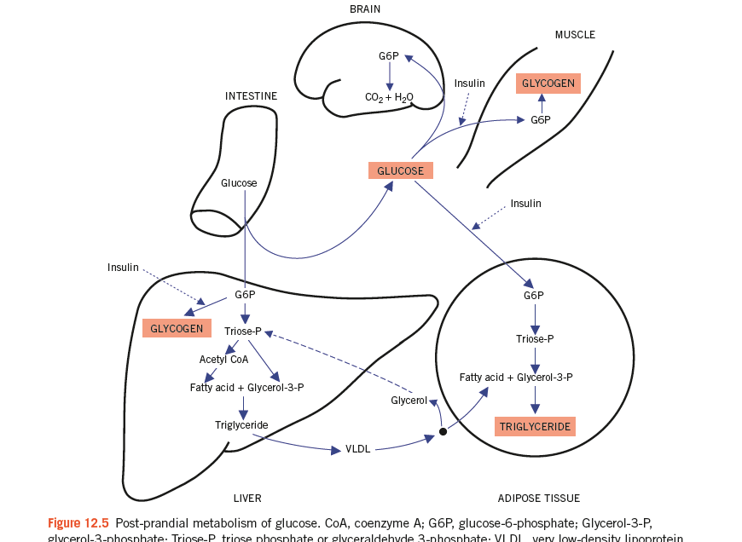

Slide 15
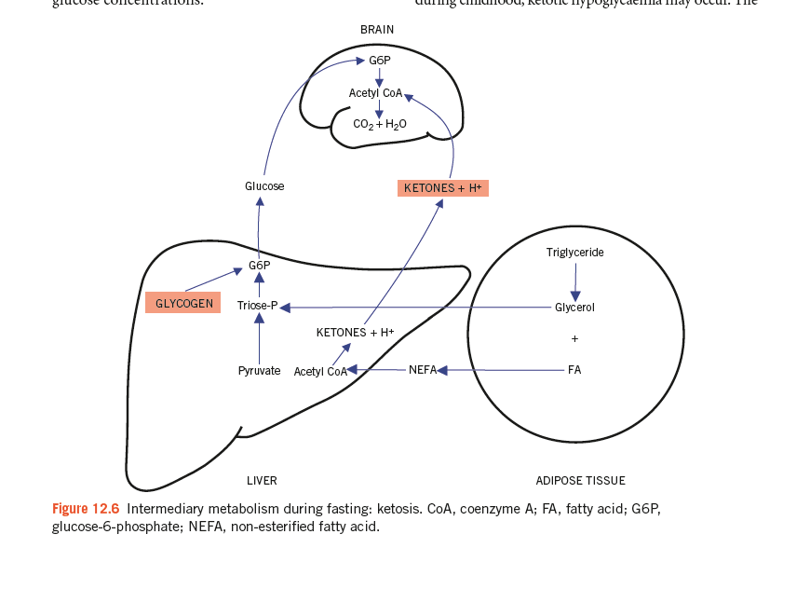

Slide 16
PHYSIOLOGICAL AND PATHOLOGICAL LATIC ACIDOSIS
-Cori cycle .
Lactic acid, produced by anaerobic glycolysis, may either
be oxidized to CO2 and water in the TCA cycle or be
re-converted to glucose by gluconeogenesis in the liver.
Both the TCA cycle and gluconeogenesis need oxygen;
anaerobic glycolysis is a non-oxygen-requiring pathway.
Pathological accumulation of lactate may occur because:
Tissue hypoxia

Slide 17
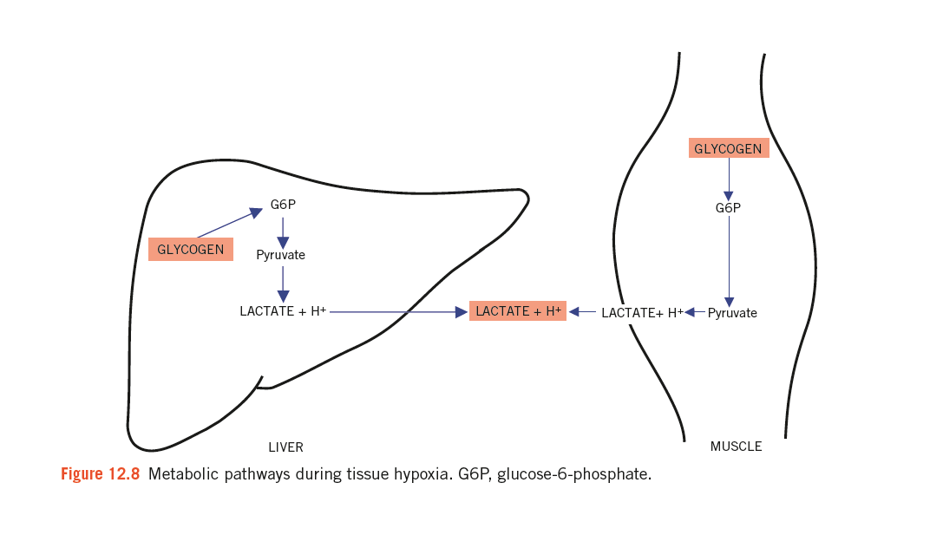

Slide 18
HYPERGLYCAEMIA AND DIABETES MELLITUS
Diabetes mellitus is caused by an absolute or relative
insulin deficiency and /or insulin resistance. It has been defined by the World Health Organization (WHO), on the basis of laboratory findings, as a fasting plasma glucose of 7.0 mmol/L or more (on more than one
occasion or once in the presence of diabetes symptoms)
or a random plasma glucose of 11.1 mmol/L or more , or HbA1c ≥ 6.5 % . Sometimes an oral glucose tolerance test (OGTT) may be required to establish the diagnosis in equivocal cases.

Slide 19
Type 1 diabetes mellitus
Previously called insulin-dependent diabetes mellitus,
this is the term used to describe the condition in patients
for whom insulin therapy is essential because they are
prone to develop ketoacidosis. It usually presents during
childhood or adolescence. Most of these cases are due to
immune-mediated processes and may be associated with
other autoimmune disorders such as Addison’s disease,
vitiligo and Hashimoto’s thyroiditis. It has been suggested
that many cases follow a viral infection that has damaged
the b-cells of the pancreatic islets.

Slide 20
Type 2 diabetes mellitus
Previously called non-insulin-dependent diabetes
mellitus, this is the most common variety worldwide
(about 90 per cent of all diabetes mellitus cases). Patients
are much less likely to develop ketoacidosis than those
with type 1 diabetes, although insulin may sometimes
be needed. Onset is most usual during adult life; there
is a familial tendency and an association with obesity.

Slide 21
Impaired glucose tolerance
The WHO definition of impaired glucose tolerance (IGT) is a fasting venous plasma glucose concentration of less than 7.0 mmol/L and a plasma glucose concentration between 7.8 mmol/L and 11.1 mmol/L
2 h after an OGTT.

Slide 22
Impaired fasting glucose
The fasting venous plasma glucose is 6.1 mmol/L
or more but less than 7.0 mmol/L, and less than
7.8 mmol/L 2 h after an OGTT.

Slide 23
END OF LECTURE THANKS FOR LISTENING

